Slide 1
Qualitative Coding with Hybrid AI and Human-in-the-Loop
Christina M. Dressel, Megan LePere-Schloop, & Lucia Gomez Teijeiro
Notes:
https://scikit-learn.org/stable/modules/generated/sklearn.metrics.multilabel_confusion_matrix.html
https://medium.com/data-science/how-to-implement-graph-rag-using-knowledge-graphs-and-vector-databases-60bb69a22759

Slide 2
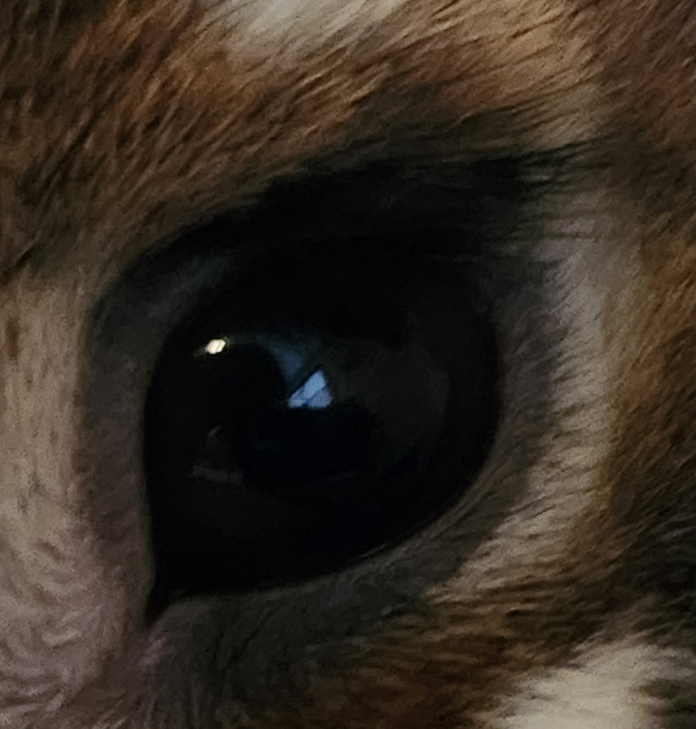
What animal does this eye belong to?
Notes:
To give you the experience of what it is like to focus on a chunk of text and engage in interpretation, I want to start with a question….what kind of animal does this eye belong to?

Slide 3
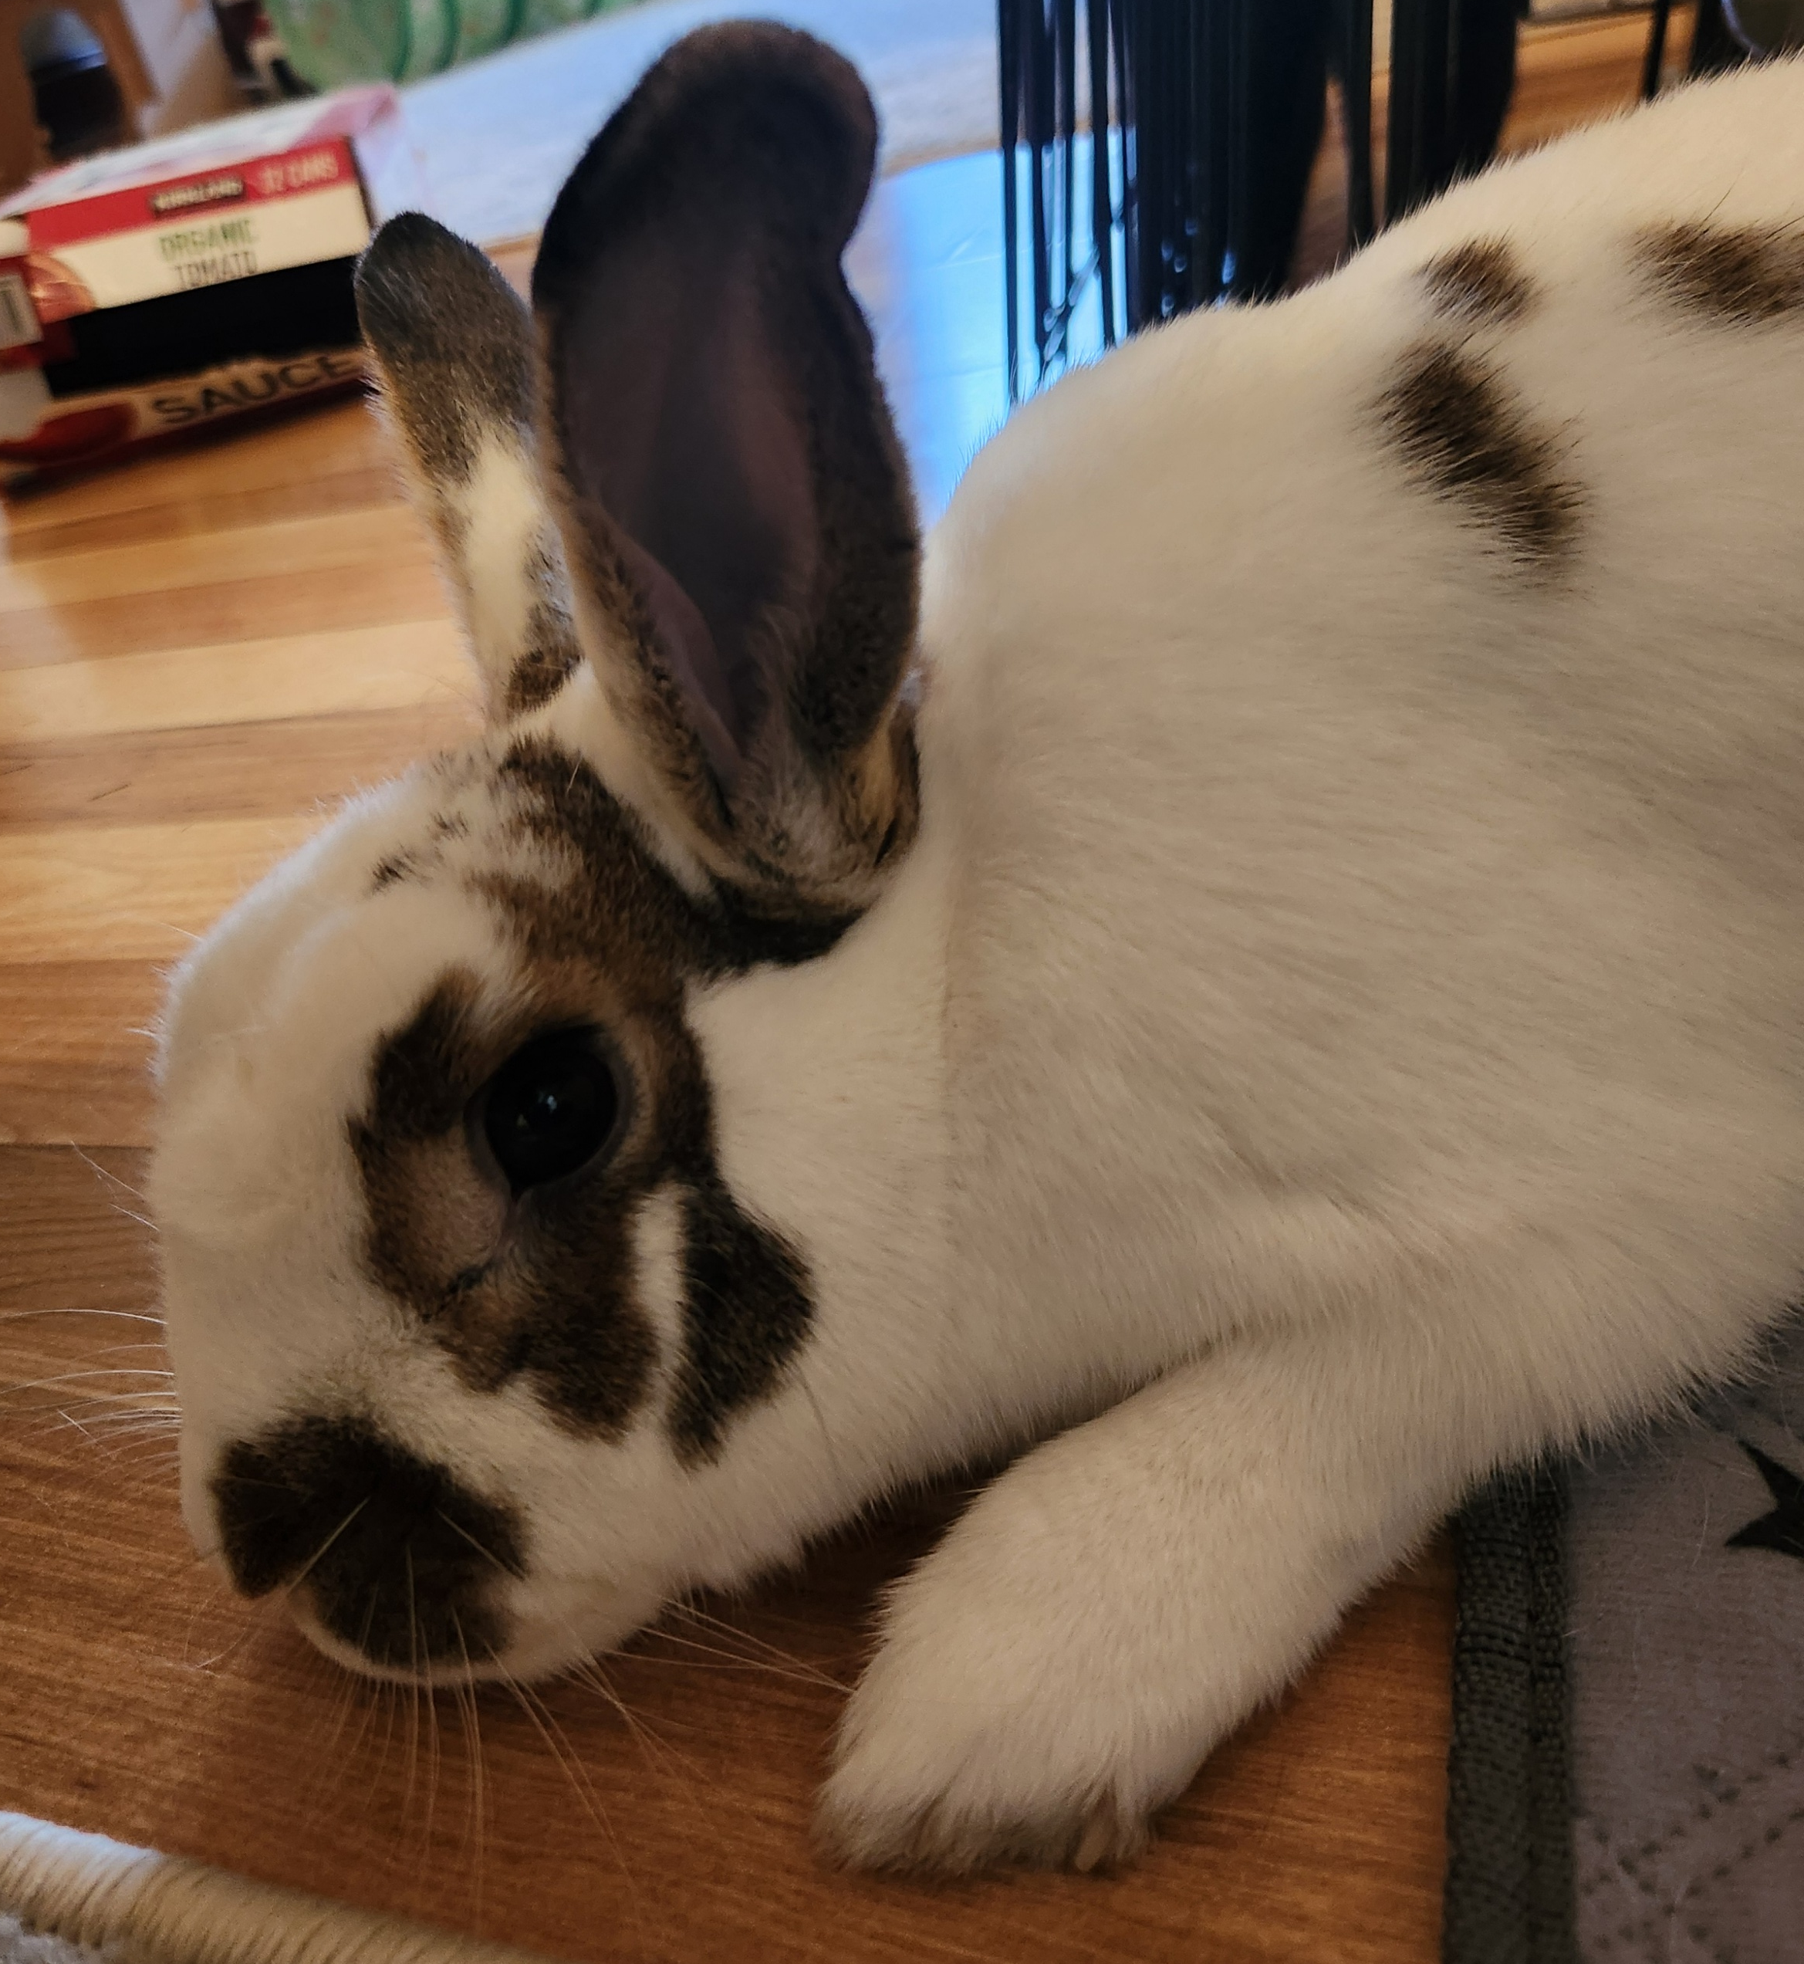
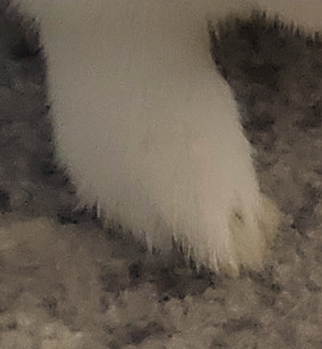
What animal does this eye belong to?
Notes:
It can be difficult to reach consensus in qualitative coding. Oftentimes, the language we are coding requires more context and interpretation.

Slide 4
Focus & Contributions
Notes:
Our goal today is to focus on methods. We look at institutional logics of community foundations as a case; I am happy to discuss this theory and context in the Q&A but for our purposes today the focus is on classifying organizational language. First, GenAI is increasingly employed for a variety of tasks, and it is important to understand how we, as scholars, can appropriately use it in our research, so we look at the role of GenAI as a partner during the qualitative coding process. This is an increasingly prominent methodological interest in computer science. Second, our approach takes theory and qualitative traditions seriously. While methods such as topic modeling and text embeddings look for patterns in data retroactively to make meaning, we are leading with theory first. Third, methods addressing language can help us understand a variety of phenomena including organizational goals, how organizations demonstrate accountability, and where power resides in the organization. Fourth, methodologically, we grapple with a complex coding task – it is continuous, and it is possible for an excerpt of language to fall under more than one class. For example, when studying organizational goals, we don’t expect each goal to be perfectly distinct. Fifth, we find that not only does a GenAI approach allow us to scale our coding beyond small n, but it also helps us refine our codebook.

Slide 5
Focus & Contributions
Illustrative case: institutional logics of community foundations (CFs)
Notes:
Our goal today is to focus on methods. We look at institutional logics of community foundations as a case; I am happy to discuss this theory and context in the Q&A but for our purposes today the focus is on classifying organizational language. First, GenAI is increasingly employed for a variety of tasks, and it is important to understand how we, as scholars, can appropriately use it in our research, so we look at the role of GenAI as a partner during the qualitative coding process. This is an increasingly prominent methodological interest in computer science. Second, our approach takes theory and qualitative traditions seriously. While methods such as topic modeling and text embeddings look for patterns in data retroactively to make meaning, we are leading with theory first. Third, methods addressing language can help us understand a variety of phenomena including organizational goals, how organizations demonstrate accountability, and where power resides in the organization. Fourth, methodologically, we grapple with a complex coding task – it is continuous, and it is possible for an excerpt of language to fall under more than one class. For example, when studying organizational goals, we don’t expect each goal to be perfectly distinct. Fifth, we find that not only does a GenAI approach allow us to scale our coding beyond small n, but it also helps us refine our codebook.

Slide 6
Focus & Contributions
Illustrative case: institutional logics of community foundations (CFs)
Understanding the role of generative AI as a coding partner (Hodges et al., 2025; Katz et al., 2024; Sammon et al, 2024; Sharma & Wallace, 2025; Wiebe et al., 2025; Xiao et al., 2023)
Notes:
Our goal today is to focus on methods. We look at institutional logics of community foundations as a case; I am happy to discuss this theory and context in the Q&A but for our purposes today the focus is on classifying organizational language. First, GenAI is increasingly employed for a variety of tasks, and it is important to understand how we, as scholars, can appropriately use it in our research, so we look at the role of GenAI as a partner during the qualitative coding process. This is an increasingly prominent methodological interest in computer science. Second, our approach takes theory and qualitative traditions seriously. While methods such as topic modeling and text embeddings look for patterns in data retroactively to make meaning, we are leading with theory first. Third, methods addressing language can help us understand a variety of phenomena including organizational goals, how organizations demonstrate accountability, and where power resides in the organization. Fourth, methodologically, we grapple with a complex coding task – it is continuous, and it is possible for an excerpt of language to fall under more than one class. For example, when studying organizational goals, we don’t expect each goal to be perfectly distinct. Fifth, we find that not only does a GenAI approach allow us to scale our coding beyond small n, but it also helps us refine our codebook.

Slide 7
Focus & Contributions
Illustrative case: institutional logics of community foundations (CFs)
Understanding the role of generative AI as a coding partner (Hodges et al., 2025; Katz et al., 2024; Sammon et al, 2024; Sharma & Wallace, 2025; Wiebe et al., 2025; Xiao et al., 2023)
Theory-driven as opposed to post-hoc meaning making
Notes:
Our goal today is to focus on methods. We look at institutional logics of community foundations as a case; I am happy to discuss this theory and context in the Q&A but for our purposes today the focus is on classifying organizational language. First, GenAI is increasingly employed for a variety of tasks, and it is important to understand how we, as scholars, can appropriately use it in our research, so we look at the role of GenAI as a partner during the qualitative coding process. This is an increasingly prominent methodological interest in computer science. Second, our approach takes theory and qualitative traditions seriously. While methods such as topic modeling and text embeddings look for patterns in data retroactively to make meaning, we are leading with theory first. Third, methods addressing language can help us understand a variety of phenomena including organizational goals, how organizations demonstrate accountability, and where power resides in the organization. Fourth, methodologically, we grapple with a complex coding task – it is continuous, and it is possible for an excerpt of language to fall under more than one class. For example, when studying organizational goals, we don’t expect each goal to be perfectly distinct. Fifth, we find that not only does a GenAI approach allow us to scale our coding beyond small n, but it also helps us refine our codebook.

Slide 8
Focus & Contributions
Illustrative case: institutional logics of community foundations (CFs)
Understanding the role of generative AI as a coding partner (Hodges et al., 2025; Katz et al., 2024; Sammon et al, 2024; Sharma & Wallace, 2025; Wiebe et al., 2025; Xiao et al., 2023)
Theory-driven as opposed to post-hoc meaning making
Applications for the study of organizations and management
Notes:
Our goal today is to focus on methods. We look at institutional logics of community foundations as a case; I am happy to discuss this theory and context in the Q&A but for our purposes today the focus is on classifying organizational language. First, GenAI is increasingly employed for a variety of tasks, and it is important to understand how we, as scholars, can appropriately use it in our research, so we look at the role of GenAI as a partner during the qualitative coding process. This is an increasingly prominent methodological interest in computer science. Second, our approach takes theory and qualitative traditions seriously. While methods such as topic modeling and text embeddings look for patterns in data retroactively to make meaning, we are leading with theory first. Third, methods addressing language can help us understand a variety of phenomena including organizational goals, how organizations demonstrate accountability, and where power resides in the organization. Fourth, methodologically, we grapple with a complex coding task – it is continuous, and it is possible for an excerpt of language to fall under more than one class. For example, when studying organizational goals, we don’t expect each goal to be perfectly distinct. Fifth, we find that not only does a GenAI approach allow us to scale our coding beyond small n, but it also helps us refine our codebook.

Slide 9
Focus & Contributions
Illustrative case: institutional logics of community foundations (CFs)
Understanding the role of generative AI as a coding partner (Hodges et al., 2025; Katz et al., 2024; Sammon et al, 2024; Sharma & Wallace, 2025; Wiebe et al., 2025; Xiao et al., 2023)
Theory-driven as opposed to post-hoc meaning making
Applications for the study of organizations and management
Multiple classes, not mutually exclusive
Notes:
Our goal today is to focus on methods. We look at institutional logics of community foundations as a case; I am happy to discuss this theory and context in the Q&A but for our purposes today the focus is on classifying organizational language. First, GenAI is increasingly employed for a variety of tasks, and it is important to understand how we, as scholars, can appropriately use it in our research, so we look at the role of GenAI as a partner during the qualitative coding process. This is an increasingly prominent methodological interest in computer science. Second, our approach takes theory and qualitative traditions seriously. While methods such as topic modeling and text embeddings look for patterns in data retroactively to make meaning, we are leading with theory first. Third, methods addressing language can help us understand a variety of phenomena including organizational goals, how organizations demonstrate accountability, and where power resides in the organization. Fourth, methodologically, we grapple with a complex coding task – it is continuous, and it is possible for an excerpt of language to fall under more than one class. For example, when studying organizational goals, we don’t expect each goal to be perfectly distinct. Fifth, we find that not only does a GenAI approach allow us to scale our coding beyond small n, but it also helps us refine our codebook.

Slide 10
Focus & Contributions
Illustrative case: institutional logics of community foundations (CFs)
Understanding the role of generative AI as a coding partner (Hodges et al., 2025; Katz et al., 2024; Sammon et al, 2024; Sharma & Wallace, 2025; Wiebe et al., 2025; Xiao et al., 2023)
Theory-driven as opposed to post-hoc meaning making
Applications for the study of organizations and management
Multiple classes, not mutually exclusive
Refining and scaling qualitative coding
Notes:
Our goal today is to focus on methods. We look at institutional logics of community foundations as a case; I am happy to discuss this theory and context in the Q&A but for our purposes today the focus is on classifying organizational language. First, GenAI is increasingly employed for a variety of tasks, and it is important to understand how we, as scholars, can appropriately use it in our research, so we look at the role of GenAI as a partner during the qualitative coding process. This is an increasingly prominent methodological interest in computer science. Second, our approach takes theory and qualitative traditions seriously. While methods such as topic modeling and text embeddings look for patterns in data retroactively to make meaning, we are leading with theory first. Third, methods addressing language can help us understand a variety of phenomena including organizational goals, how organizations demonstrate accountability, and where power resides in the organization. Fourth, methodologically, we grapple with a complex coding task – it is continuous, and it is possible for an excerpt of language to fall under more than one class. For example, when studying organizational goals, we don’t expect each goal to be perfectly distinct. Fifth, we find that not only does a GenAI approach allow us to scale our coding beyond small n, but it also helps us refine our codebook.

Slide 11
Focus & Contributions
Illustrative case: institutional logics of community foundations (CFs)
Understanding the role of generative AI as a coding partner (Hodges et al., 2025; Katz et al., 2024; Sammon et al, 2024; Sharma & Wallace, 2025; Wiebe et al., 2025; Xiao et al., 2023)
Theory-driven as opposed to post-hoc meaning making
Applications for the study of organizations and management
Multiple classes, not mutually exclusive
Refining and scaling qualitative coding
Can GenAI be used to refine and apply theory-driven qualitative coding with multiple, overlapping classes?
Notes:
Our goal today is to focus on methods. We look at institutional logics of community foundations as a case; I am happy to discuss this theory and context in the Q&A but for our purposes today the focus is on classifying organizational language. First, GenAI is increasingly employed for a variety of tasks, and it is important to understand how we, as scholars, can appropriately use it in our research, so we look at the role of GenAI as a partner during the qualitative coding process. This is an increasingly prominent methodological interest in computer science. Second, our approach takes theory and qualitative traditions seriously. While methods such as topic modeling and text embeddings look for patterns in data retroactively to make meaning, we are leading with theory first. Third, methods addressing language can help us understand a variety of phenomena including organizational goals, how organizations demonstrate accountability, and where power resides in the organization. Fourth, methodologically, we grapple with a complex coding task – it is continuous, and it is possible for an excerpt of language to fall under more than one class. For example, when studying organizational goals, we don’t expect each goal to be perfectly distinct. Fifth, we find that not only does a GenAI approach allow us to scale our coding beyond small n, but it also helps us refine our codebook.

Slide 12
Case: ILs of Community Foundations (CFs)
Community foundations are
  place-based grantmaking public charities that collect donations from a broad base of individuals and distribute funds
Ideal CF logics (Paarlberg, 2023)
  Philanthropic Community Trust (PCT)
  Donor Services (DS)
  Public-Private Governance (PPG)
  Social Change (SC)
Annual reports for the years 2005-2023 for all 900 CFs across the US
  Working with a sample
Notes:
We conducted historical and qualitative analyses that assisted in the construction and refinement of a codebook capturing the four logics of community foundations. I am not going to spend time talking about this context because it is in service of our broader methodological question. We are assuming there are these four logics. While they overlap, they are distinct enough that it is possible to discern between them. *slow down* to highlight the four logics. I want you to be familiar with the different names because I will use them throughout the presentation.

Slide 13
 | Philanthropic Community Trust Logic | Donor Services Logic | Public-Private Governance Logic | Social Change Logic
Taken for Granted Ideational Elements (norms, values, schemas)
How community is defined | Shared sense of identity, values, and traditions of people from a geographic place | The interests, values, and identities of individual donors | Interdependence and shared fate of people in a geographic place | Socially constructed and contested process
Basis of ideal of community philanthropy: Roles and responsibilities of those with privilege | Social Darwinism and civic culture produce an obligation for those who have benefitted from a place to give back. | Philanthropy is an individual expressive act. | Scientific philanthropy, welfare capitalism, and neoliberalism regard private action as the preferred solution to social problems. | All people have inalienable rights to basic needs. The privileged have a moral obligation to right wrongs and stand up for those who are marginalized.
Why the CF exists | Growing and preserving capital, building community legacy, giving back to maintain a sense of place, and responding to the community's emerging needs. | Mobilize donors and “steward” funds so donors can leave a personal legacy. | Provide private solutions to public issues. It emphasizes cross-sector collaboration and strategic investment based on community needs. | Dismantle barriers that perpetuate disparity and inequality.
Basis of CF identity | Community Charitable Bank | Philanthropic Wealth Advisor | Community Leader, Convener | Advocate for Marginalized
Material Elements (practices, behaviors)
Who is centered in grantmaking processes and decisions | Reactive grantmaking that centers community betterment as understood by elites and established grantees and applicants. | Grantmaking preference for scholarships and charities— regardless of place. It centers the interests, values and identities of donors. | Research-based grantmaking that centers long-term community interests as understood by experts, professionals, and formal leaders. | Participatory, trust-based grantmaking that centers the lived experiences and insights of marginalized residents.
Resource base for grantmaking and operational expenses | Unrestricted endowments, bequests | Management fees from donor-advised funds | Diversified funding including program-related investments, grants to the CF, public contracting | Democratized donor base, giving circles
Donors’ Relationship to CF | Community Legacy Resource | Transactional Client | Community Impact Investors | Allies
Notes:
We conducted historical and qualitative analyses to create a theory-driven codebook.

Slide 14
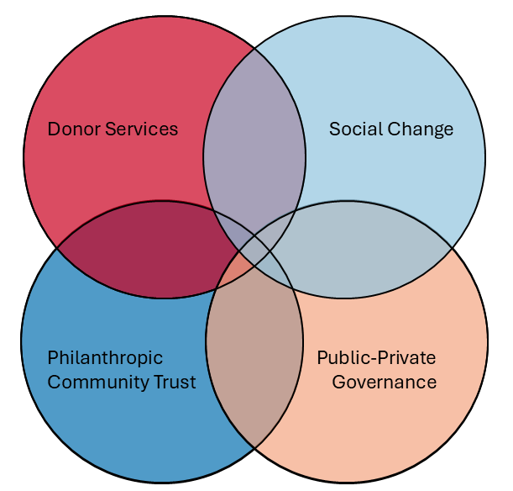
Community Foundation Logics
(DS)
(SC)
(PCT)
(PPG)
Notes:
Here are the four CF logics. Again, they are distinct in many respects but have points of overlap. In addition, a single excerpt may reflect more than one logic.

Slide 15
What do you find most interesting our helpful about our process?
Notes:
We would like your feedback! Please let us know what you find most interesting or helpful about our journey of using computational/AI approaches as a qualitative coding partner. We intend to frame our paper as a guide for other scholars interested in taking their qualitative coding to scale to analyze organizational language.

Slide 16
AI Approaches
Notes:
Using our codebook grounded in previous historical and qualitative analyses, we have engaged in a series of computational approaches to achieve our qualitative coding goals. We will touch on text embeddings, TF-IDF narratives, and spend most of our time discussing prompt refinement.

Slide 17
AI Approaches
Text Embeddings
Notes:
Using our codebook grounded in previous historical and qualitative analyses, we have engaged in a series of computational approaches to achieve our qualitative coding goals. We will touch on text embeddings, TF-IDF narratives, and spend most of our time discussing prompt refinement.

Slide 18
AI Approaches
Understand what is distinct about the logics
Text Embeddings
Notes:
Using our codebook grounded in previous historical and qualitative analyses, we have engaged in a series of computational approaches to achieve our qualitative coding goals. We will touch on text embeddings, TF-IDF narratives, and spend most of our time discussing prompt refinement.

Slide 19
AI Approaches
Understand what is distinct about the logics
Text Embeddings
TF-IDF Narratives
Notes:
Using our codebook grounded in previous historical and qualitative analyses, we have engaged in a series of computational approaches to achieve our qualitative coding goals. We will touch on text embeddings, TF-IDF narratives, and spend most of our time discussing prompt refinement.

Slide 20
AI Approaches
Understand what is distinct about the logics
Text Embeddings
Codebook refinement and further understanding of similarities and distinctions
TF-IDF Narratives
Notes:
Using our codebook grounded in previous historical and qualitative analyses, we have engaged in a series of computational approaches to achieve our qualitative coding goals. We will touch on text embeddings, TF-IDF narratives, and spend most of our time discussing prompt refinement.

Slide 21
AI Approaches
Understand what is distinct about the logics
Text Embeddings
Codebook refinement and further understanding of similarities and distinctions
TF-IDF Narratives
Prompt Refinement
Notes:
Using our codebook grounded in previous historical and qualitative analyses, we have engaged in a series of computational approaches to achieve our qualitative coding goals. We will touch on text embeddings, TF-IDF narratives, and spend most of our time discussing prompt refinement.

Slide 22
AI Approaches
Understand what is distinct about the logics
Text Embeddings
Codebook refinement and further understanding of similarities and distinctions
TF-IDF Narratives
GenAI shows potential for continuous classification
Prompt Refinement
Notes:
Using our codebook grounded in previous historical and qualitative analyses, we have engaged in a series of computational approaches to achieve our qualitative coding goals. We will touch on text embeddings, TF-IDF narratives, and spend most of our time discussing prompt refinement.

Slide 23





AI Approaches
Understand what is distinct about the logics
Text Embeddings
Human Coders
Codebook refinement and further understanding of similarities and distinctions
TF-IDF Narratives
GenAI shows potential for continuous classification
Prompt Refinement
GenAI
Notes:
Using our codebook grounded in previous historical and qualitative analyses, we have engaged in a series of computational approaches to achieve our qualitative coding goals. We will touch on text embeddings, TF-IDF narratives, and spend most of our time discussing prompt refinement. These approaches involved iterative interactions with GenAI where we prompted AI, engaged with it, and discussed the findings with one another.

Slide 24
Text Embeddings
Text Embeddings
  Vector representations of words in a text
Principal Components Analysis (PCA)
Uniform Manifold Approximation and Projection (UMAP)
Notes:
Our first approach was to take our excerpts (batches of language from annual reports ranging from a couple words to multiple sentences) and converting them to embeddings. We then visualized them with PCA (principal component analysis) to see if the excerpts formed four distinct groups, in line with our codebook. It did not. The PCA visualization is very reductionist but provides a glimpse into how our text sits. This is a helpful approach for some tasks, but our task is too complicated due to the substantial overlap between logics. However, we became interested in component 1 and wanted to understand what was happening along that axis. Both PCA and UMAP are unsupervised clustering approaches…although we will be looking at a supervised version of the UMAP.

Slide 25
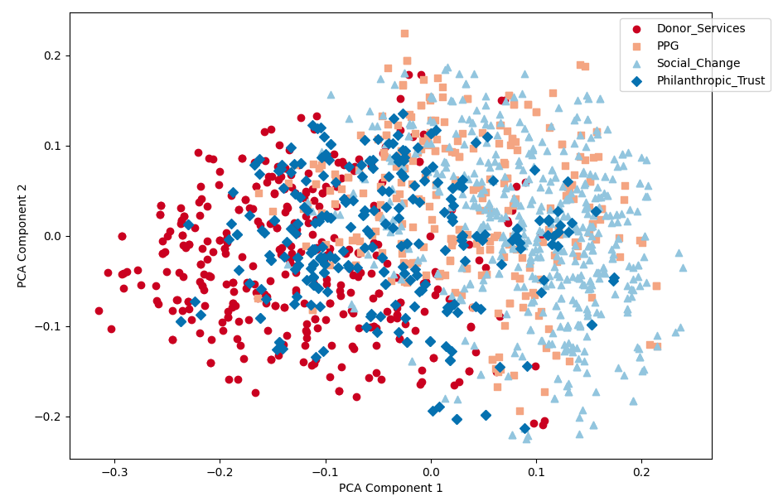
Text Embeddings
Philanthropic Community Trust
Donor Services
Public-Private Governance
PCA Component 2
Social Change
PCA Component 1

Slide 26
Text Embeddings
Philanthropic Community Trust
Donor Services
Public-Private Governance
PCA Component 2
Social Change
PCA Component 1
Notes:
To understand Component 1, we grabbed excerpts that fell -0.2 or less as “low” and 0.2 or greater as “high”. We calculated TF-IDFs to see which words were most important that sat at either end of component 1.

Slide 27
TF-IDF Narratives
fund
residents
gift
funds
17
transitoriented
foundation
development
PCA Component 2
donor
black
communities
charitable
chicagoans
advised
donors
households
grants
latinx
designated
access
PCA Component 1
Notes:
We used TF-IDF (Term Frequency-Inverse Document Frequency) to look at “top words” associated with low and high values of PCA component 1. Here are the top words that came out of our TF-IDF. This helped us see that at the ends of the visualization there was some agreement around PCT at one end and SC at the other. However, words like “grants” and “foundation” also sit across all the logics.

Slide 28
TF-IDF Narratives cont.
Prompt:
I have two sets of words that represent different narratives or themes.
Please analyze the differences between the two sets and describe the narratives or themes they represent.
[feed words]
What are the differences in the narratives or themes between these two sets of words? Please provide a detailed analysis.
Truncated Response:
These two sets of words represent contrasting approaches to community betterment. Set 1 depicts a traditional, philanthropic model of giving, while Set 2 represents a more focused and socially conscious approach that aims to address systemic inequalities and empower specific marginalized communities. The PCA component likely separates these two philosophies or approaches to community development based on their underlying language and emphasis.
Notes:
We then passed these words to an LM and asked it to explain the themes within each set of words. Here is our prompt. This stage represents our first real attempt at a human-in-the-loop approach. Here is a piece of sample output. This helped us understand us understand some of the distinctions between logics.

Slide 29
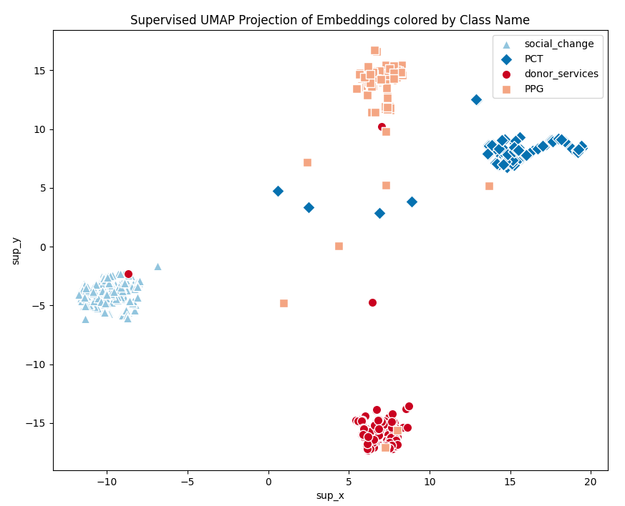
“Misclassified” Points from UMAP
Philanthropic Community Trust
Donor Services
Public-Private Governance
Social Change
Notes:
We then used a supervised UMAP (Uniform Manifold Approximation and Projection) to force our embeddings into classes and we got more clarity but still some misclassified points. Here I am defining misclassified as any point not cleanly sitting in the four logic clusters.

Slide 30
“Misclassified” Points from PCA/UMAP
Prompt:
I have excerpts grouped by different logics. Please analyze the narratives and themes present in each logic. Then, compare the narratives and themes between the logics. What is similar or different?
Now that you have analyzed the four logics, here are some excerpts that were misclassified:
Why do you think these excerpts were misclassified? Please provide an analysis.
Feedback:
Overlapping Themes Lack of Specificity Difficulty Distinguishing Intent | Misinterpreting "Community” Too Focused on Keywords Focus on Outcomes
Notes:
We also looked at misclassified points (classifications that did not match our manual/hand-coded labeled data) and asked the LM to explain why it thought the excerpts were misclassified. We received helpful feedback addressing what it was about those excerpts that may have resulted in a “misclassification.”

Slide 31
Prompt Schema
Task Information
Logic Definitions
  Decision rules
Classification Instructions
Formatting Instructions
Markdown styling
Excerpt
Notes:
At this point, we took what we learned from our embedding visualizations to focus on optimizing a prompt to feed to an LM for conducting a classification task. We start with basic information about the task and context – CFs, logics, etc. and then move into brief definitions of each logic, including some “decision rules” that came out of collaboration with the LM. For example: Excerpts emphasizing cross-sector collaboration, tourism, or economic developments should be classified as public private governance whereas excerpts where the initiative purpose is advancing equity should be classified as the social change logic. We used markdown in different parts of the prompt to focus the attention of the LM – capitals, exclamation points, etc. We provided clear instructions for how the LM should classify and format its output. Finally, we fed the LM an excerpt.

Slide 32
Prompt Accuracy Stats
Direct Match
Accuracy Measure | PCT | DS | PPG | SC
Precision | 0.990 | 0.996 | 0.991 | 0.993
Recall | 0.714 | 0.749 | 0.396 | 0.858
Harmonic Mean | 0.829 | 0.854 | 0.565 | 0.920
Average Uncertainty | 0.668 | 0.577 | 0.774 | 0.604
Interrater Reliability Kappa: 0.623
Notes:
Here are some accuracy stats we calculated to understand how the LM was performing. Precision looks at the whether the decisions the LM made reflect our hand-coding. For example, in 99% of cases that the LM assigned the highest weight to philanthropic community trust, our hand-coded logic was philanthropic community trust. Recall looks at how much of the LM’s coding captured our hand-codes. For example, 82.9% of what we coded as PCT was correctly identified by the LM. The harmonic mean takes precision and recall together. We calculated the average uncertainty of each excerpt as a normalized entropy function to estimate how peaked (certain) vs uniform (uncertain) each set of weights was. We also calculated the stats for a “realistic” match where we counted a classification as correct if the LM assigned a weight of 40 or more to our hand-coded logic. This is reasonable because our themes are overlapping and while our hand-codes only reflect the primary logic, we have asked the LM to engage in multi-class coding. A weight of 40 allows for us to identify excerpts that reflect genuine recognition of the hand-coded logic without including noise (such as 25–25–25–25 or 30–30–30–10 splits).

Slide 33
Prompt Accuracy Stats
Direct Match
“Realistic” Match
Accuracy Measure | PCT | DS | PPG | SC
Precision | 0.990 | 0.996 | 0.991 | 0.993
Recall | 0.714 | 0.749 | 0.396 | 0.858
Harmonic Mean | 0.829 | 0.854 | 0.565 | 0.920
Average Uncertainty | 0.668 | 0.577 | 0.774 | 0.604
Accuracy Measure | PCT | DS | PPG | SC
Precision | 0.611 | 0.887 | 0.787 | 0.896
Recall | 0.795 | 0.788 | 0.464 | 0.895
Harmonic Mean | 0.691 | 0.834 | 0.583 | 0.895
Average Uncertainty | 0.668 | 0.577 | 0.774 | 0.604
Interrater Reliability Kappa: 0.623
Interrater Reliability Kappa: 0.70
Notes:
Here are some accuracy stats we calculated to understand how the LM was performing. Precision looks at the whether the decisions the LM made reflect our hand-coding. For example, in 99% of cases that the LM assigned the highest weight to philanthropic community trust, our hand-coded logic was philanthropic community trust. Recall looks at how much of the LM’s coding captured our hand-codes. For example, 82.9% of what we coded as PCT was correctly identified by the LM. The harmonic mean takes precision and recall together. We calculated the average uncertainty of each excerpt as a normalized entropy function to estimate how peaked (certain) vs uniform (uncertain) each set of weights was. We also calculated the stats for a “realistic” match where we counted a classification as correct if the LM assigned a weight of 40 or more to our hand-coded logic. This is reasonable because our themes are overlapping and while our hand-codes only reflect the primary logic, we have asked the LM to engage in multi-class coding. A weight of 40 allows for us to identify excerpts that reflect genuine recognition of the hand-coded logic without including noise (such as 25–25–25–25 or 30–30–30–10 splits).

Slide 34
Prompt Accuracy Stats
Direct Match
“Realistic” Match
Accuracy Measure | PCT | DS | PPG | SC
Precision | 0.990 | 0.996 | 0.991 | 0.993
Recall | 0.714 | 0.749 | 0.396 | 0.858
Harmonic Mean | 0.829 | 0.854 | 0.565 | 0.920
Average Uncertainty | 0.668 | 0.577 | 0.774 | 0.604
Accuracy Measure | PCT | DS | PPG | SC
Precision | 0.611 | 0.887 | 0.787 | 0.896
Recall | 0.795 | 0.788 | 0.464 | 0.895
Harmonic Mean | 0.691 | 0.834 | 0.583 | 0.895
Average Uncertainty | 0.668 | 0.577 | 0.774 | 0.604
Interrater Reliability Kappa: 0.623
Interrater Reliability Kappa: 0.70
Notes:
Here are some accuracy stats we calculated to understand how the LM was performing. Precision looks at the whether the decisions the LM made reflect our hand-coding. For example, in 99% of cases that the LM assigned the highest weight to philanthropic community trust, our hand-coded logic was philanthropic community trust. Recall looks at how much of the LM’s coding captured our hand-codes. For example, 82.9% of what we coded as PCT was correctly identified by the LM. The harmonic mean takes precision and recall together. We calculated the average uncertainty of each excerpt as a normalized entropy function to estimate how peaked (certain) vs uniform (uncertain) each set of weights was. We also calculated the stats for a “realistic” match where we counted a classification as correct if the LM assigned a weight of 40 or more to our hand-coded logic. This is reasonable because our themes are overlapping and while our hand-codes only reflect the primary logic, we have asked the LM to engage in multi-class coding. A weight of 40 allows for us to identify excerpts that reflect genuine recognition of the hand-coded logic without including noise (such as 25–25–25–25 or 30–30–30–10 splits).

Slide 35
Public-Private Governance Failed Match Examples
“strategic grantmaking”
(excerpt 7)
Logic | PCT | DS | PPG | SC
Weight | 30 | 20 | 30 | 20
“The Community Impact Fund, a mechanism to provide financial resources to Long Beach nonprofits, was established to create real solutions to local challenges. Each year the LBCF Board of Directors identify the most pressing issues facing our city. For more than two decades, LBCF has worked closely with nonprofits who are on the front line of housing and homelessness, poverty, education, youth development, mental health, crime prevention, and more.”
(excerpt 18)
Logic | PCT | DS | PPG | SC
Weight | 60 | 0 | 20 | 20
Notes:
These are two PPG excerpts that failed both our direct and relaxed match standards. In the first example, it is evident there is not enough context for the LM to make a confident decision. In the second case, its weight disagrees with our coding but is actually reasonable. We are trying to leave space for the LM to provide suggestions that may disagree with our coding but be reasonable as is the case when working with a team of human coders and working to reach consensus. As we have developed prompts, we have gone through incorrectly classified excerpts to make sense of these differences and find which ones are “reasonable” and which ones truly fail to align with our codebook. We use this information to refine our prompts.

Slide 36
Contributions & Takeaways
Notes:
The goal of this study is to experiment with different ways of integrating AI into our coding process. We are building trust with AI so that we can feel comfortable and confident allowing it to classify organizational language at scale.

Slide 37
Contributions & Takeaways
Theory-driven
Notes:
The goal of this study is to experiment with different ways of integrating AI into our coding process. We are building trust with AI so that we can feel comfortable and confident allowing it to classify organizational language at scale.

Slide 38
Contributions & Takeaways
Theory-driven
Applications to the management field
Notes:
The goal of this study is to experiment with different ways of integrating AI into our coding process. We are building trust with AI so that we can feel comfortable and confident allowing it to classify organizational language at scale.

Slide 39
Contributions & Takeaways
Theory-driven
Applications to the management field
Addresses a complex coding task
Notes:
The goal of this study is to experiment with different ways of integrating AI into our coding process. We are building trust with AI so that we can feel comfortable and confident allowing it to classify organizational language at scale.

Slide 40
Contributions & Takeaways
Theory-driven
Applications to the management field
Addresses a complex coding task
Refining and scaling qualitative coding
Notes:
The goal of this study is to experiment with different ways of integrating AI into our coding process. We are building trust with AI so that we can feel comfortable and confident allowing it to classify organizational language at scale.

Slide 41
Contributions & Takeaways
Theory-driven
Applications to the management field
Addresses a complex coding task
Refining and scaling qualitative coding
Treating GenAI as a coding partner
  An imperfect process of meeting, discussing, and agreeing
  Directing human attention
Notes:
The goal of this study is to experiment with different ways of integrating AI into our coding process. We are building trust with AI so that we can feel comfortable and confident allowing it to classify organizational language at scale.

Slide 42
Next Steps…
Comparing output across LMs
Prompting multiple times and checking for consistency
Few shot prompting and/or few shot learning
Incorporate a knowledge graph into LLM prompts to facilitate the automatic, linguistically nuanced, and consistent application of the codebook to the full corpus of documents (Pan et al., 2024)
Fine-tuning and specialized language model

Slide 43
Thank you — I welcome your questions and feedback.
Notes:
Thank you for listening to our learning journey with GenAI, and I look forward to your questions and feedback.

Slide 44
References
Auerbach, C., & Silverstein, L. B. (2003). Qualitative Data: An Introduction to Coding and Analysis. NYU Press.
Hodges, A., Ponce, T., & Seawright, L. (2025). AI-Assisted Qualitative Coding: Comparing Human to Machine Outputs. 2025 IEEE International Professional Communication Conference (ProComm), 230–233. https://doi.org/10.1109/ProComm64814.2025.00051
Højgaard Christiansen, L., & Lounsbury, M. (2013). Strange Brew: Bridging Logics Via Institutional Bricolage and the Reconstitution of Organizational Identity. In M. Lounsbury & E. Boxenbaum (Eds.), Research in the Sociology of Organizations (pp. 199–232). Emerald Group Publishing Limited. https://doi.org/10.1108/S0733-558X(2013)0039b020
Katz, A., Fleming, G. C., & Main, J. (2024). Thematic Analysis with Open-Source Generative AI and Machine Learning: A New Method for Inductive Qualitative Codebook Development (No. arXiv:2410.03721). arXiv. https://doi.org/10.48550/arXiv.2410.03721
LePere-Schloop, M. (2022). Nonprofit Role Classification Using Mission Descriptions and Supervised Machine Learning. Nonprofit and Voluntary Sector Quarterly, 51(5), 1207–1222. https://doi.org/10.1177/08997640211057393
LePere-Schloop, M., Walk, M., & Paarlberg, L. E. (2024). “We Expected a Revolution and Got a Slow Burn”: Microfoundations of Institutional Change in the Community Foundation Field. Nonprofit and Voluntary Sector Quarterly, 53(1), 159–185. https://doi.org/10.1177/08997640231152240
Ma, J. (2021). Automated Coding Using Machine Learning and Remapping the U.S. Nonprofit Sector: A Guide and Benchmark. Nonprofit and Voluntary Sector Quarterly, 50(3), 662–687. https://doi.org/10.1177/0899764020968153
Paarlberg, L. E. (2023). The Antecedents and Consequences of Multiple Logics in Community Foundations [Paper presentation]. European Research Network on Philanthropy (ERNOP) Conference 2023, Zagreb, Croatia.
Pan, S., Luo, L., Wang, Y., Chen, C., Wang, J., & Wu, X. (2024). Unifying Large Language Models and Knowledge Graphs: A Roadmap. IEEE Transactions on Knowledge and Data Engineering, 36(7), 3580–3599. https://doi.org/10.1109/TKDE.2024.3352100
Saldaña, J. (2021). The Coding Manual for Qualitative Researchers (4th ed.). SAGE.
Sammon, D., McCarthy, S., Thummadi, B. V., Wibisono, A., & Fitzgerald, B. (2024). Exploring the Potential of Large Language Models (LLMs) for Grounded Theorizing: A Human-in-the-Loop Configuration. ICIS 2024 Proceedings.
Sharma, A., & Wallace, J. R. (2025). DeTAILS: Deep Thematic Analysis with Iterative LLM Support. Proceedings of the 7th ACM Conference on Conversational User Interfaces, 1–7. https://doi.org/10.1145/3719160.3735657
Thornton, P. H., & Ocasio, W. (1999). Institutional Logics and the Historical Contingency of Power in Organizations: Executive Succession in the Higher Education Publishing Industry, 1958– 1990. American Journal of Sociology, 105(3), 801–843. https://doi.org/10.1086/210361
Wiebe, J. P., Khan, R., Burns, S., & Slotta, J. D. (2025.). Qualitative Research in the Age of LLMs: A Human-in-the-Loop Approach to Hybrid Thematic Analysis. ICLS 2025 Proceedings.
Xiao, Z., Yuan, X., Liao, Q. V., Abdelghani, R., & Oudeyer, P.-Y. (2023). Supporting Qualitative Analysis with Large Language Models: Combining Codebook with GPT-3 for Deductive Coding. 28th International Conference on Intelligent User Interfaces, 75–78. https://doi.org/10.1145/3581754.3584136

Slide 45
Defining Institutional Logics (ILs)
“the socially constructed, historical pattern of material practices, assumptions, values, beliefs, and rules by which individuals produce and reproduce their material subsistence, organize time and space, and provide meaning to their social reality” (Thornton & Ocasio, 1999, p. 804).
Notes:
Symbolic elements/language. Complicated definition – ILs. people speech and organizations talk in their documents. Material practices – decisions. This study focuses on language but we expect it to relate to how organizations behave.

Slide 46
 | Philanthropic Community Trust Logic | Donor Services Logic | Public-Private Governance Logic | Social Change Logic
Taken for Granted Ideational Elements (norms, values, schemas)
How community is defined | Shared sense of identity, values, and traditions of people from a geographic place | The interests, values, and identities of individual donors | Interdependence and shared fate of people in a geographic place | Socially constructed and contested process
Basis of ideal of community philanthropy: Roles and responsibilities of those with privilege | Social Darwinism and civic culture produce an obligation for those who have benefitted from a place to give back. | Philanthropy is an individual expressive act. | Scientific philanthropy, welfare capitalism, and neoliberalism regard private action as the preferred solution to social problems. | All people have inalienable rights to basic needs. The privileged have a moral obligation to right wrongs and stand up for those who are marginalized.
Why the CF exists | Growing and preserving capital, building community legacy, giving back to maintain a sense of place, and responding to the community's emerging needs. | Mobilize donors and “steward” funds so donors can leave a personal legacy. | Provide private solutions to public issues. It emphasizes cross-sector collaboration and strategic investment based on community needs. | Dismantle barriers that perpetuate disparity and inequality.
Basis of CF identity | Community Charitable Bank | Philanthropic Wealth Advisor | Community Leader, Convener | Advocate for Marginalized
Material Elements (practices, behaviors)
Who is centered in grantmaking processes and decisions | Reactive grantmaking that centers community betterment as understood by elites and established grantees and applicants. | Grantmaking preference for scholarships and charities— regardless of place. It centers the interests, values and identities of donors. | Research-based grantmaking that centers long-term community interests as understood by experts, professionals, and formal leaders. | Participatory, trust-based grantmaking that centers the lived experiences and insights of marginalized residents.
Resource base for grantmaking and operational expenses | Unrestricted endowments, bequests | Management fees from donor-advised funds | Diversified funding including program-related investments, grants to the CF, public contracting | Democratized donor base, giving circles
Donors’ Relationship to CF | Community Legacy Resource | Transactional Client | Community Impact Investors | Allies

Slide 47
Logic | Excerpt Examples from Qualitative Coding
Philanthropic Community Trust Logic | “Our responsibility to you—to our region—is to use our assets wisely in support of your deep commitment to the vital work” “To inspire others forever, join our 235+ Legacy Society Members.” “Unrestricted funds provide flexibility to respond to the broad and changing needs in the community, now and in the future.”
Donor Services Logic | “Many of the funds are endowed, and all have the purpose of helping with causes our donors care about. Anyone can be a philanthropist.” “All these types of funds can be set up in a way to memorialize a loved one or honor a family/individual.” “All donations allow individuals to directly engage in philanthropy – giving to those things that matter most to them.” “Establish a charitable fund now, so you can see the impact of your generosity on community charities”

Slide 48
Logic | Excerpt Examples from Qualitative Coding
Public-Private Governance Logic | “We offer support beyond the grant check. We strive to be champions for our grantees, amplify their work, and serve as a connector and partner.” “We offer a number of opportunities for fund advisors to engage in impact investing.” “The robust strategic planning process, guided by our consulting team…included numerous surveys, focus groups and one-on-one interviews with community leaders” “The [foundation] is a resource, a connector and a facilitator, nimble and ready to respond to community needs as they evolve”
Social Change Logic | “[Place-based community]: an inclusive community. Together. Forward. Bold. An exceptional place where everyone thrives.” “Access to higher education is vital to creating thriving, equitable communities” “We prioritize investing in BIPOC-led organizing and systems change work. We know this work is often overlooked, underfunded, and underestimated.” “Social Justice Fund supports work to obtain equitable economic, political & social opportunities for all” “Despite the obstacles, we continue to strive for a region where opportunity and prosperity are within reach for all.”

Slide 49
What Can ILs Help Us Learn?
Multiple levels of analysis
Guide sensemaking and decision-making
Shape attention
Stability and change
Organizational identity
Responses to institutional complexity (Greenwood et al., 2011)
Institutional bricolage (Højgaard Christiansen & Lounsbury, 2013)
Notes:
Organizations negotiate identity change by leveraging resources from different logics across time and space (Højgaard Christiansen & Lounsbury, 2013).

Slide 50
Evidence of Institutional Bricolage

Slide 51
Data
Current corpus is 2,822 annual reports
Collection process is active, and we are contacting organizations that do not have reports posted online
Qualitative stratified sample
  Stratifying the population of CFs with at least one publicly available annual report from 2010-2023 by asset size (small, medium, large) using financial data collected through IRS 990 forms
  1-2 organizations reflecting each logic (LePere-Schloop et al., 2024)

Slide 52
Tools
Python, using Gemini API
  Flash 2.0
  Context window is up to 1 million tokens

Slide 53
Computational Approaches
Term Frequency-Inverse Document Frequency (TF-IDF)
  Measures word importance by balancing frequency and rarity across a corpus
Principal Component Analysis (PCA)
  Represents embeddings and reduces dimensionality to 2 or 3 components
  Maximizes variability
Uniform Manifold Approximation Projection – supervised (UMAP)
  Distance between points, with respect for labels

Slide 54
Phase 1: Qualitative Approach

Slide 55
Case: ILs of Community Foundations (CFs)
Community foundations are
  place-based grantmaking public charities that collect donations from a broad base of individuals and distribute funds
Ideal CF logics (Paarlberg, 2023)
  Philanthropic Community Trust
  Donor Services
  Public-Private Governance
  Social Change Philanthropy
Institutional bricolage (Højgaard Christiansen & Lounsbury, 2013)
Notes:
Service provision and who has access. Grantmaking decisions. Highlight practice and language. We focus on language but we are ultimately interested in practice. For each logic, we’re interested in the language that reflects them. Ultimately, we want it to reflect behavior. why we care originally, one would be dominate and win out. Now the thinking is institutional bricolage. Combination of logics.

Slide 56
Qualitative Approach
Constructed a codebook of ideal CF logics
Stratified random sample of twenty-five reports
Two-cycle coding
  Provisional (Saldaña, 2021)
  Elaborative (Auerbach & Silverstein, 2003)
Final codes were applied to annual report excerpts
Notes:
To identify language from annual reports reflecting each ideal CF logic, we used a two-cycle process involving both provisional and elaborative coding (Saldaña, 2021). Following Goodrick and Reay (2011) who identified pharmacy work characteristics associated with four ideal type ILs of pharmacy, we used relevant academic and practitioner sources to identify values and practices for each ideal type CF logic described earlier. This table of values and practices associated with the four ideal CF logics was used as a provisional codebook during first-cycle coding (Miles et al., 2014) and refined during elaborative coding
Actually organizational language in use, we did two cycle coding process

Slide 57
Qualitative Findings
Philanthropic Community Trust: “Our responsibility to you—to our region—is to use our assets wisely in support of your deep commitment to the vital work.”
Donor Services: “All donations allow individuals to directly engage in philanthropy – giving to those things that matter most to them.”
Public-Private Governance: “We offer support beyond the grant check. We strive to be champions for our grantees, amplify their work, and serve as a connector and partner.”
Social Change: “Social Justice Fund supports work to obtain equitable economic, political & social opportunities for all.”
Notes:
Contribution – we did find language that reflected each logic. Through that process we refined our codebook. Just do one, why we care? Pure reflections but we also found evidence of institutional bricolages.

Slide 58
An Overview: AI & Human-in-the-loop
Ask a GenAI for the narratives present in the qualitative excerpts
Integrate narratives with codebook language as a prompt
Identify scenarios where LM classification does not align with qualitative codes
Shift toward continuous classification
Again, identify failed cases
Asking GenAI for feedback about prompt
Attending to details
  Setting a role
  Signaling important rules

Slide 59
Measuring Performance of Human-in-the-Loop Codes
Harmonic mean of precision and recall (Ma, 2020)
  Precision – “how many predicted observations are correct?” (p. 675)
  Recall – “how many observations are correctly predicted?” (p. 675)
Intercoder reliability (Landis & Koch, 1977)
  Should be between 0.80-1.00
  Kappa measure

Slide 60
Example of Inconsistent LM Output
“WE BENEFIT WHEN ALL CHICAGOANS HAVE THE OPPORTUNITY TO PARTICIPATE IN OUR ECONOMY.”
(excerpt 311,315)
Justification: RawScores=PCT=5;DS=5;PPG=10;SC=80; The excerpt broadly mentions economic opportunity, which could relate to the community, but it is not explicitly about responsible fund management, so it receives a low score. The excerpt does not mention donor preferences or vehicles, so it receives a low score. The excerpt hints at economic development, but it is not explicitly about cross-sector collaboration, so it receives a low score. The excerpt focuses on equitable economic participation, aligning with the social change logic.
Justification: RawScores=PCT=0;DS=0;PPG=0;SC=100; The excerpt focuses on economic opportunity for all Chicagoans, which aligns with addressing systemic inequities and promoting a more inclusive society, thus Social Change. There is no mention of fund management, donor intent, or cross-sector collaboration, so the other logics are not applicable.
Notes:
Example of inconsistent classification decision for the same excerpt. If we treat LM like a coding partner, may be too much to expect that it comes up with the same response every time. For example, as human coders, we might revisit the same codes and make different decisions.

Slide 61
Knowledge Graph
Emerging findings from human-in-the-loop strategies informed codebook improvement
LM used refined codebook to produce a knowledge graph of subject-predicate-object relationships
This is what a knowledge graph is, this is why we think it would be a good thing to try
  ML with rules-based approach

Slide 62
Public-Private Governance Failed Match Examples
“strategic grantmaking”
(excerpt 7)
Justification: RawScores=PCT=3;DS=2;PPG=3;SC=2; Strategic grantmaking suggests responsible allocation of funds (PCT). It could be aligned with donor intent (DS). It could also be part of a larger public-private initiative (PPG). It could also be part of a social change initiative (SC).
RawScores=PCT=60;DS=0;PPG=20;SC=20; The excerpt describes the Community Impact Fund as a mechanism to address local challenges, aligning with the foundation's role in improving the community. There is no mention of donor influence or preferences, so donor services is not applicable. The excerpt mentions the board identifying pressing issues and working with nonprofits, suggesting a collaborative approach to problem-solving. The excerpt mentions addressing issues like poverty and education, which can be linked to social change, but the framing is more general than focusing on systemic inequities.
“The Community Impact Fund, a mechanism to provide financial resources to Long Beach nonprofits, was established to create real solutions to local challenges. Each year the LBCF Board of Directors identify the most pressing issues facing our city. For more than two decades, LBCF has worked closely with nonprofits who are on the front line of housing and homelessness, poverty, education, youth development, mental health, crime prevention, and more.”
(excerpt 18)
Notes:
These are two PPG excerpts that failed both our direct and relaxed match standards. In the first example, it is evident there is not enough context for the LM to make a confident decision. In the second case, its weight disagrees with our coding but is actually reasonable. We are trying to leave space for the LM to provide suggestions that may disagree with our coding but be reasonable as is the case when working with a team of human coders and working to reach consensus. As we have developed prompts, we have gone through incorrectly classified excerpts to make sense of these differences and find which ones are “reasonable” and which ones truly fail to align with our codebook. We use this information to refine our prompts.

Slide 63
GenAI Challenges for Qualitative Coding
Context
  Generalization
  Excerpt size
Rule “strictness”
  “assign each logic an independent integer raw_score from 0 to 5 (0 = absent, 5 = exclusive/overwhelming emphasis). Convert the raw scores to integer probabilities (points) that sum to exactly 100.”
Forgetting
Inconsistencies across iterations
Notes:
If the prompt is too long or you are feeding it too much information, the LM can “forget” some of the instructions (experienced this when we fed the report for context). Formatting consistency – need to be clear about the exact format you would like returned. LM is trained on a vast amount of data so it will often make an inference about what “social change” means even if it doesn’t align with our prompt.

Slide 64
Prompt
I am going to provide a series of excerpts. An excerpt can be as short as one word or as long as multiple paragraphs. You are evaluating text excerpts for the presence of four logics. All excerpts are pulled from community foundation annual reports, so there will be a lot of similar language across excerpts including but not limited to community foundations, philanthropy, communities, and donors. In some cases, an excerpt may represent only one logic; in other cases, multiple logics may be present within a single excerpt. Here are brief definitions of each logic, with some decision rules:
Philanthropic Community Trust: The philanthropic community trust logic focuses on the foundations commitment to the principled investment, stewardship, and management of donor funds. It stresses transparency, accountability, and effective investment strategies. This logic emphasizes flexibility and responsiveness, via unrestricted endowments and fast responses to the communitys most pressing needs. Thus, the community foundation addresses both immediate needs and plans for the long-term needs of the foundation and the community. This logic highlights local identity, connecting donors and organizations within the local community, supporting local needs, and improving the place that community members live, learn, work, and play. However, this logic should not be treated as a 'catch all.' Philanthropic Community Trust applies for excerpts discussing responsible management of funds, asset growth, emergency/rapid funding, and improving the community.
Notes:
Here is our prompt. We start with some background information about the excerpts, initial instructions, and move into definitions of each logic.

Slide 65
Prompt cont.
Donor Services: The donor services logic centers upon the desires and intents of donors. Under this logic, the community foundation tailors giving strategies to align individual donor values and charitable goals to help them create lasting personal legacies. Donor-advised funds are a staple of this logic, and grantmaking occurs under the advisement of donors so that impact aligns with their values. Under this logic, the community foundation also highlights the variety of giving vehicles available to suit donor needs.
Public Private Governance: The public-private governance logic emphasizes the role of formal leaders in addressing social problems through cross-sector collaborations, community leadership, economic development, and impact investing to achieve common goals. The community foundation acts as a central connector and convenor, promoting economic opportunities and improving the overall prosperity of the region. Under this logic, the community foundation may focus on making targeted investments in specific projects and initiatives that will yield measurable results. The community foundation may play a role in shaping policy. The public-private governance logic focuses on initiatives that address the root causes of problems through the lens of efficiency, data, and cross-sector collaboration; this is distinct from the social change logic which seeks to challenge the structural barriers that produce inequality by empowering marginalized voices. Excerpts emphasizing cross-sector collaboration, tourism, or economic developments should be classified as public private governance whereas excerpts where the initiative purpose is advancing equity should be classified as the social change logic.
Notes:
Logic definitions cont.

Slide 66
Prompt cont.
Social Change: The social change logic focuses on addressing systemic inequities and creating a more just and inclusive society. Under this logic, the community foundation supports grassroots organizations and community-led initiatives, particularly to empower marginalized community members. Some excerpts may describe initiatives such as expanding access to education, training, and employment; if the initiative is framed in terms of addressing inequity, barriers, or improving accessibility, the excerpt should be classified as social change. The social change logic also includes fostering conversations around diversity, equity, and inclusion. Some excerpts may talk about an investment strategy, but it should not be labeled as philanthropic community trust if it refers to investing with environmental, social, and governance principles—in that case, the excerpt should be classified as social change. Social change is about negotiating diverse values (race, ethnicity, class, gender, religion, politics, etc.) and dismantling barriers that perpetuate inequality; thus, the social change logic is more specific than just social impact more generally. When both Public-Private Governance and Social Change are potentially applicable, prioritize Social Change if the framing emphasizes equity, empowerment, or systemic barriers.
CLASSIFY EVERY EXCERPT (NO SKIPS!), even if it is very short, ambiguous, or truncated. Never skip, output “unclear,” or add text outside the required format. If uncertain, make your best guess and assign probabilities that still sum to 100."
Notes:
We also added an instruction to not skip any excerpts, and we gave this command in all caps with an exclamation point to add emphasis. Sometimes the LM will refuse to code if it is uncertain, so this forces it to make a decision.

Slide 67
Prompt cont.
For each excerpt, assign probabilities for the presence of each logic (summing to 100). Do not rely solely on keywords like 'equity' or 'collaboration'; instead, examine why they are mentioned and in what context. Explain your reasoning for the weight assigned to each of the four logics. Avoid general explanations—address each logic individually with a specific justification.
The Justification field must contain: (a) the raw scores used, in this compact form: RawScores=PCT=x;DS=y;PPG=z;SC=w; (b) then a concise, per-logic explanation corresponding to those raw scores (one sentence per logic). If any logic has <= 10 probability points, explicitly state why that small allocation was given.
**If you do not respond in exactly the following format, your task will be considered failed:**
ID: <Excerpt_ID> | Philanthropic Community Trust Probability | Donor Services Probability | Public Private Governance Probability | Social Change Probability | Justification
Do not include ID numbers or quotation marks. Only return the probability number, not the associated header. Respond ONLY in this format. Do not include headers, intro statements, or explanations.
Notes:
Added an instruction not to over-rely on key words but to appreciate their use in the broader excerpt context. We provided a specific output format we are looking for and were strict in our wording of this command.

Slide 68
Additional Classification Examples
“As we emerge from the shadow of the pandemic we continue to fulfill our mission of positively impacting the Long Beach community through charitable giving, stewardship,”
(excerpt 5)
Logic | PCT | DS | PPG | SC
Weight | 40 | 0 | 20 | 40
“Patrice started The Breaking Bread Village in 2020 in response to the anger and divisiveness she saw in the country, particularly on social media. With the pandemic, the election, and George Floyd’s murder, ‘2020 was a crazy year for everyone,’ she said. The Breaking Bread Village aims to unite people and create connections by intentionally listening and exploring differing viewpoints.”
(excerpt 60)
Logic | PCT | DS | PPG | SC
Weight | 10 | 10 | 30 | 50
Notes:
Excerpt 5 is an example that did not meet the direct match but did satisfy the “realistic” match for PCT. The justification is problematic, however, because it makes a lot of inferences to assign weights. Here is the justification “Justification=RawScores=PCT=4;DS=0;PPG=2;SC=4;Philanthropic Community Trust is present due to the mention of charitable giving and stewardship, suggesting responsible management of resources and a commitment to the community. Donor Services is not present because the excerpt does not mention donor preferences or strategies. Public Private Governance is present due to the focus on impacting the community, which could involve cross-sector collaborations and initiatives. Social Change is present due to the focus on positively impacting the community, which could involve addressing systemic inequities and creating a more just society.” For excerpt 60, the direct match does align with our coding of social change. The problematic aspect of that classification is that the LM “sprinkles” points to PCT and DS that don’t really fit. “RawScores=PCT=1;DS=1;PPG=3;SC=5; Philanthropic Community Trust is low because the excerpt focuses on social connection rather than financial stewardship. Donor Services is low because the excerpt does not mention donor intent or legacy. Public Private Governance is moderate because uniting people could be seen as a form of community leadership. Social Change is high because the initiative directly addresses divisiveness and aims to unite people across differing viewpoints, which aligns with negotiating diverse values.”

Slide 69
Additional Classification Examples Cont.
“The types of funds can be set up in a way to memorialize a loved one or honor a family/individual.”
(excerpt 77)
Logic | PCT | DS | PPG | SC
Weight | 0 | 90 | 0 | 10
“Serving as a resource, catalyst and coordinator for charitable activities”
(excerpt 103)
Logic | PCT | DS | PPG | SC
Weight | 25 | 25 | 25 | 25
Notes:
The classification of excerpt 77 strongly resonates with our codebook, except for the LM’s understanding of social change. The LM provided this justification: “Justification=RawScores=PCT=0;DS=9;PPG=0;SC=1; The excerpt focuses on memorializing loved ones and honoring families/individuals, which aligns strongly with donor intent and legacy planning, thus Donor Services. There is no mention of community benefit, fund management, or cross-sector collaboration, so Philanthropic Community Trust and Public Private Governance receive 0. The mention of honoring individuals could be interpreted as a nod to their social contributions, but it's weak, so Social Change receives a small allocation.” We coded excerpt 103 as PPG but the LM was unsure and when this excerpt popped up again (excerpt 104) the allocation was slightly different but still uncertain. It is good example of how the LM just doesn’t have the specialized knowledge we do about key words that trigger us to identify a certain logic/framing/ideology. Here was the provided justification: “Justification: RawScores=PCT=25;DS=25;PPG=25;SC=25; The excerpt is very general and could apply to any of the logics, as it describes the foundation's role in facilitating charitable activities without specifying the nature of those activities or the target beneficiaries. The excerpt does not provide enough information to favor one logic over another, so each is assigned an equal probability.”

